Slide 1
House PRICE PREDICTION
By: PREETI SINGH

Slide 2
Problem Statement
Houses are one of the necessary needs of each and every person around the globe and therefore housing and real estate market is one of the markets which is one of the major contributors in the world’s economy. It is a very large market and there are various companies working in the domain. Data science comes as a very important tool to solve problems in the domain to help the companies increase their overall revenue, profits, improving their marketing strategies and focusing on changing trends in house sales and purchases. Predictive modelling, Market mix modelling, recommendation systems are some of the machine learning techniques used for achieving the business goals for housing companies. Our problem is related to one such housing company.

Slide 3
Domain problem
Observation Based on the above data, we can drop the following columns - LotFrontage - Alley - FireplaceQu - PoolQC - Fence - MiscFeature - Id (dropping this not because of count, irrelevant) - MoSold (dropping this not because of count, irrelevant) - Street (dropping this not because of count, irrelevant) - Utilities (dropping this not because of count, irrelevant) Review of Literature
This is a comprehensive summary of the research done on the topic. The review should enumerate, describe, summarize, evaluate and clarify the research done.

Slide 4
Analytical problem framing
Data contains 1460 entries each having 81 variables. Data contains Null values. We need to treat them using the domain knowledge and our own understanding. Extensive EDA has to be performed to gain relationships of important variable and price. Data contains numerical as well as categorical variable. We need to handle them accordingly. We have to build Machine Learning models, apply regularization and determine the optimal values of Hyper Parameters. We need to find important features which affect the price positively or negatively. Two datasets are being provided to you (test.csv, train.csv). We will train on train.csv dataset and predict on test.csv file.

Slide 5
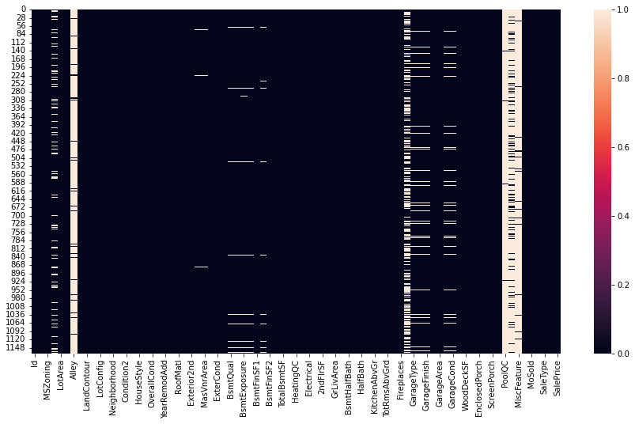
Data Pre-processing done
Storing null values in train, then printing columns with more than 0 null values Impute missing values Dropping columns which has around 50 percent missing values Selecting categorical features and encoded get dummies of input features Scaling input and test data using MinMaxScaler module.

Slide 6
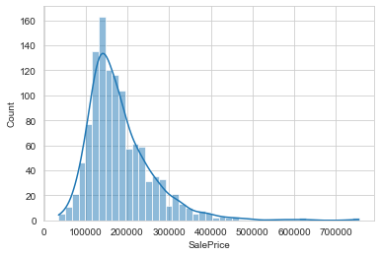
EDA Steps and Visualization

Slide 7
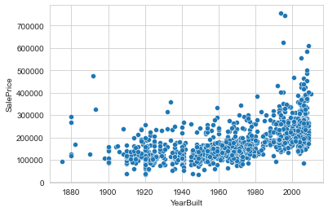
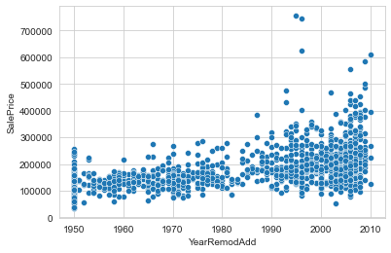
Scatter plot of year vs sales price

Slide 8
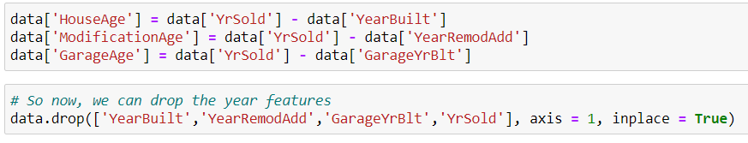
Feature engineering steps

Slide 9
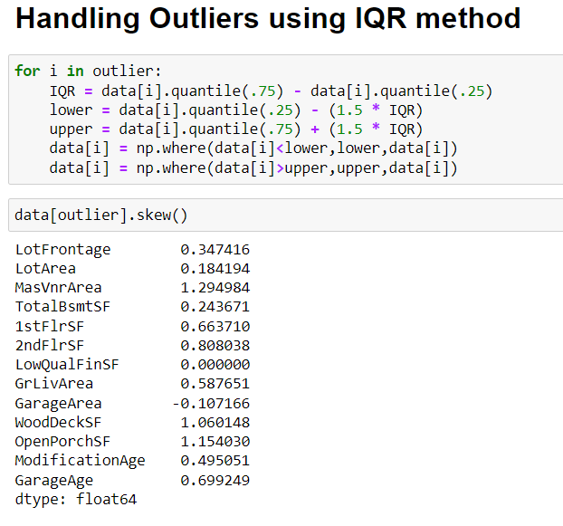
Handling Outliers

Slide 10
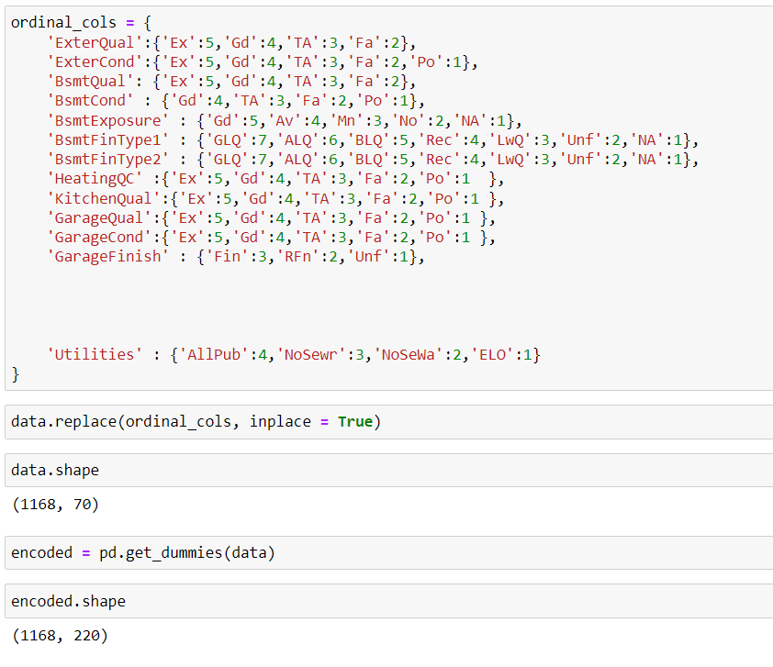
Encoding Categorical features

Slide 11
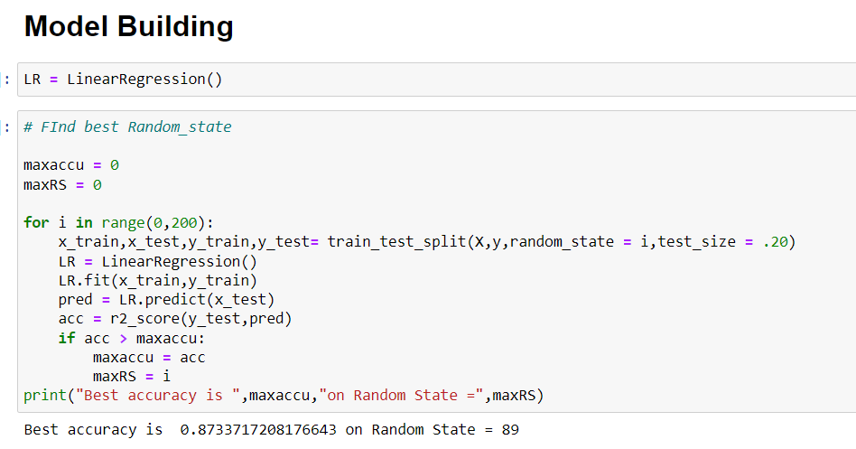
Model building with best random state

Slide 12
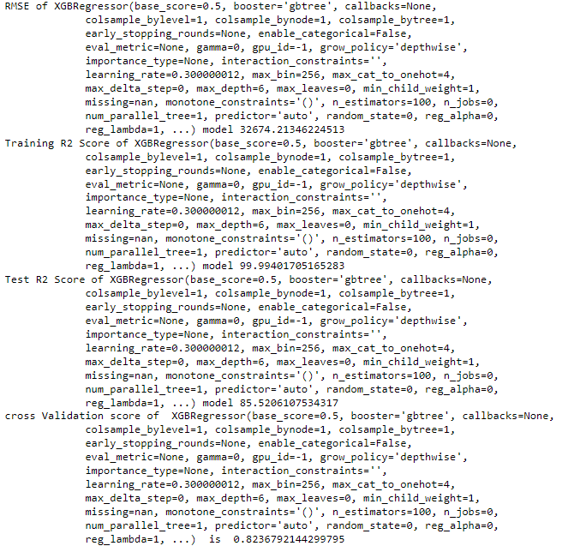
Best model performance
XGBoost Score Before Hyper Tuning
RMSE: 32674.21346224513
Training R2 Score: 99%
Testing R2 score: 85%
Cross validation Score 0.82.
XGBoost Score After Hyper Tuning
Training R2 Score: 98%
Testing R2 score: 88%

Slide 13
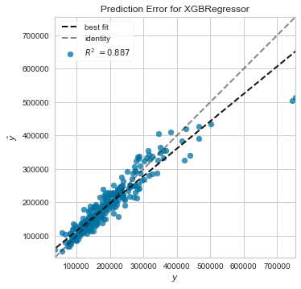
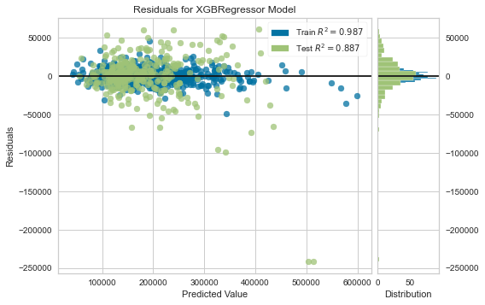
Visualization of error residuals

Slide 14
Conclusion
I used various different types of models and used R2 score, RSME score and Cross Validation Score to determine which model is best. After training and testing all the models I have came to this conclusion that XGBoost Regressor is giving the best performance with 88% test R2 score, 98% of training R2 score, 0.82 cross validation score, RMSE score 32674.21346224513.

Slide 15
Thank you
From: Preeti Singh

